Slide 1
Data Storage Solutions
Sri Sandeep Sakthivel, Chittalummoodu Biju Bimal, Harsha Chowdhary

Slide 2
Grocery Dataset Summary
The Grocery Sales Database is a structured relational dataset designed for analyzing sales transactions, customer demographics, product details, employee records, and geographical information across multiple cities and countries. This dataset is ideal for data analysts, data scientists, and machine learning practitioners looking to explore sales trends, customer behaviors, and business insights.

Slide 3
Dataset ETL Considerations
During our ETL process, we identified a few data quality aspects typical of real-world datasets:
Missing Values: The SalesDate column in sales.csv had NULL values, requiring handling (filtering or mapping to an "Unknown" dimension member).
Incomplete Calculations: The TotalPrice in sales.csv was 0, necessitating derivation from Quantity and UnitPrice.
Data Type Alignment: Mismatches in integer sizes (e.g., SMALLINT vs. INT) and string types (e.g., CHAR padding) between source and destination required careful handling.
Scale of Data: With 6.6 million rows in sales.csv, we were unable to run SSRS reports for the whole data, so we had drop rows and made our row count 5000 rows.

Slide 4
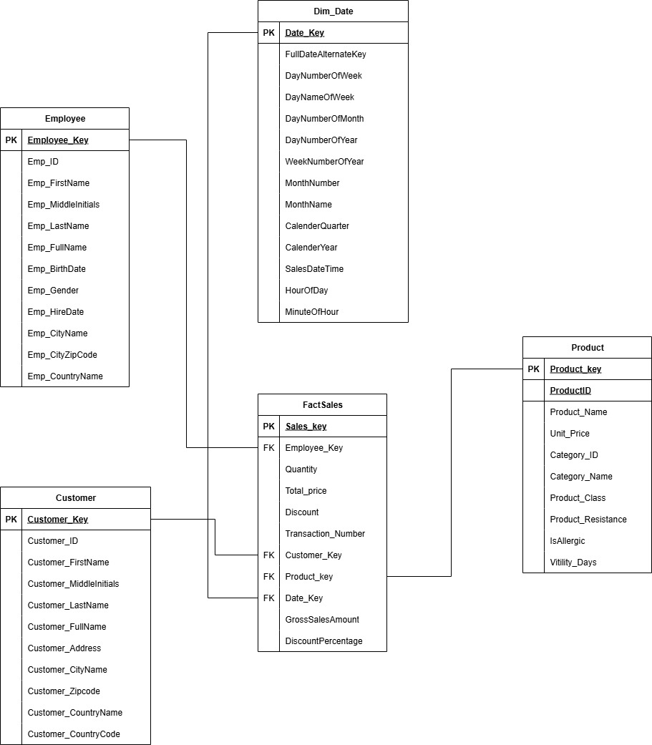
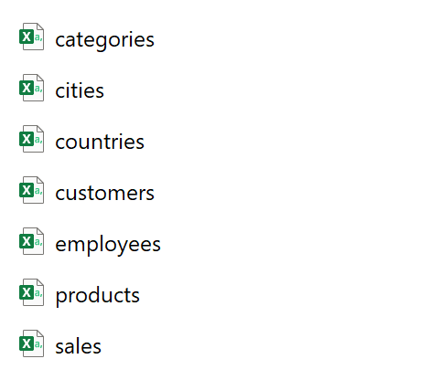
DaTA WAREHOUSE DESIGN

Slide 5
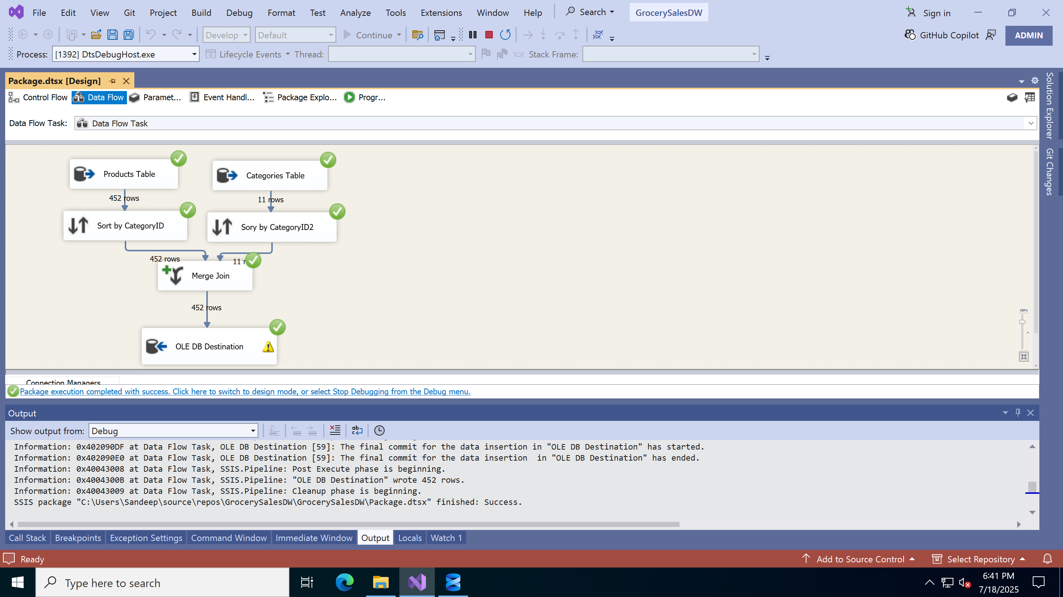
Populating Product Dimension

Slide 6
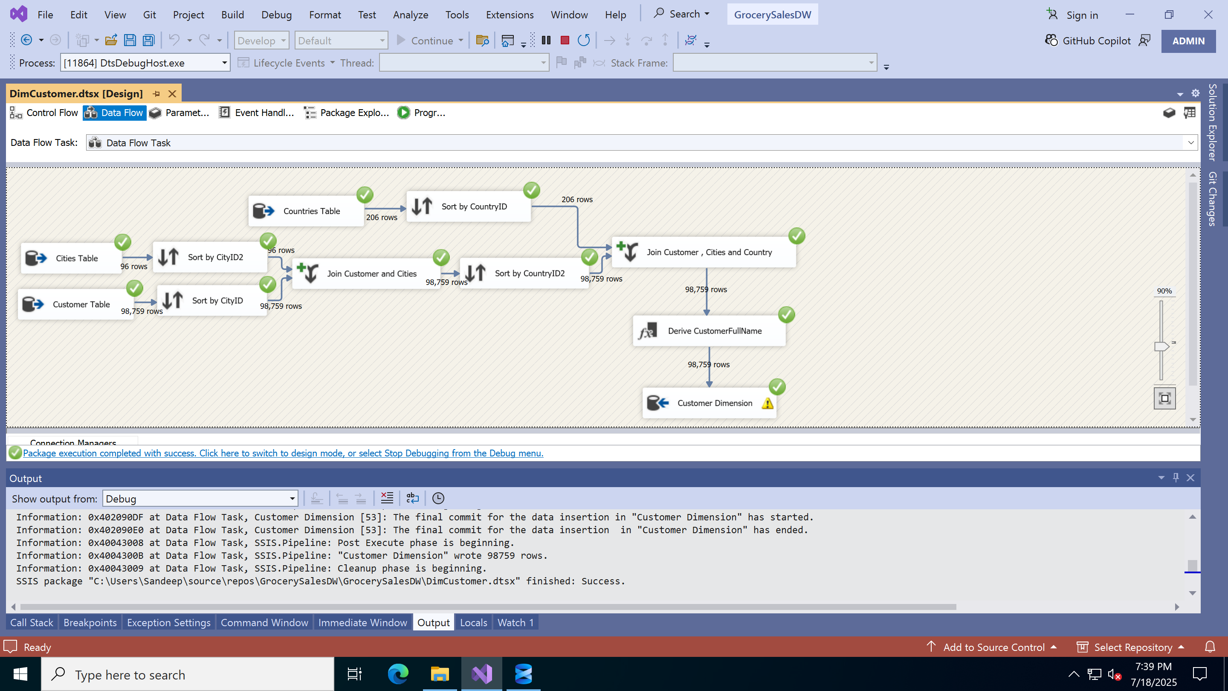
Customer Dimension

Slide 7
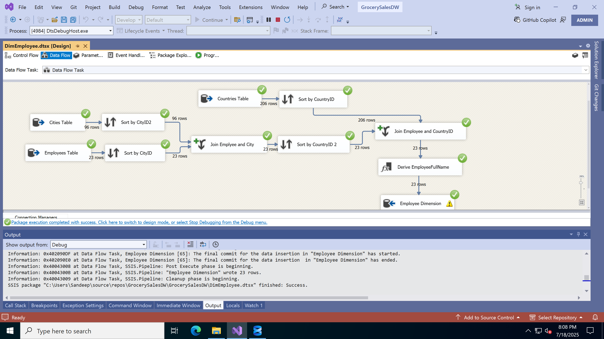
Employee Dimension

Slide 8
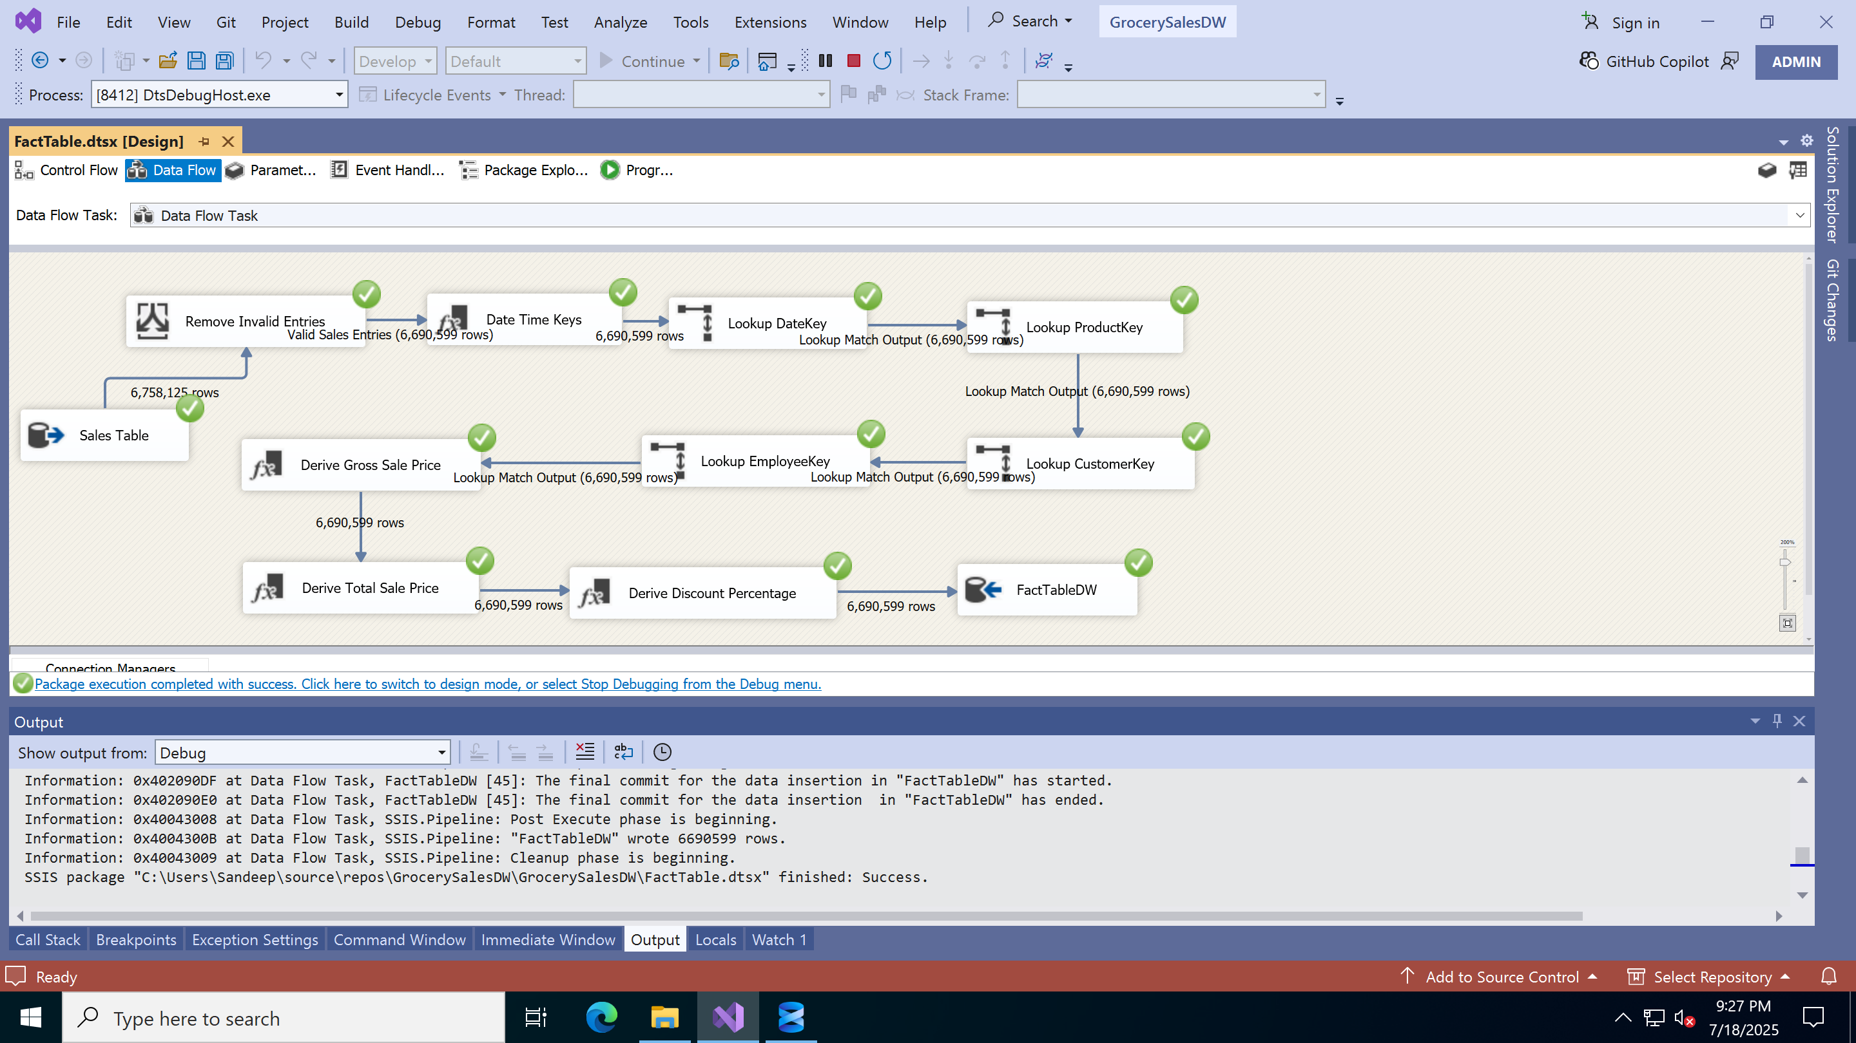
Fact Table

Slide 9

Reports - Demo

Slide 10
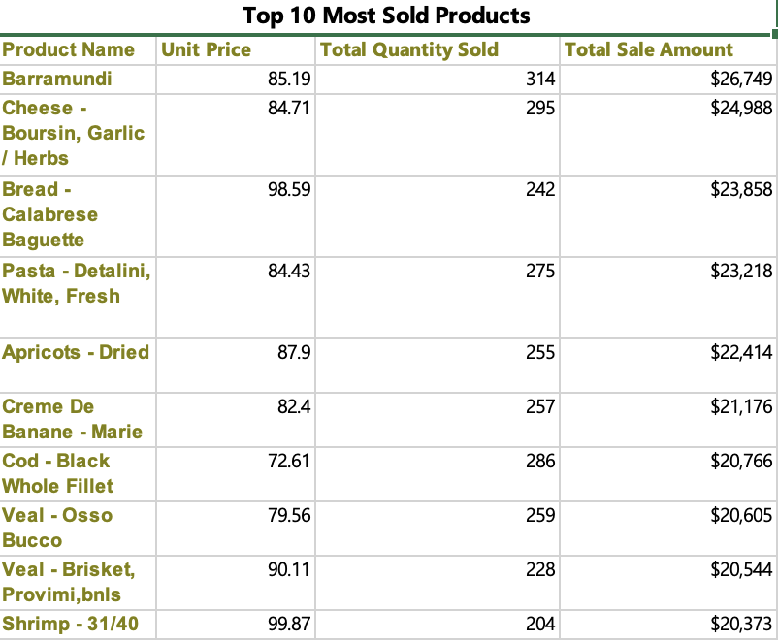
SSRS Report TOP 10 Products SOLD

Slide 11
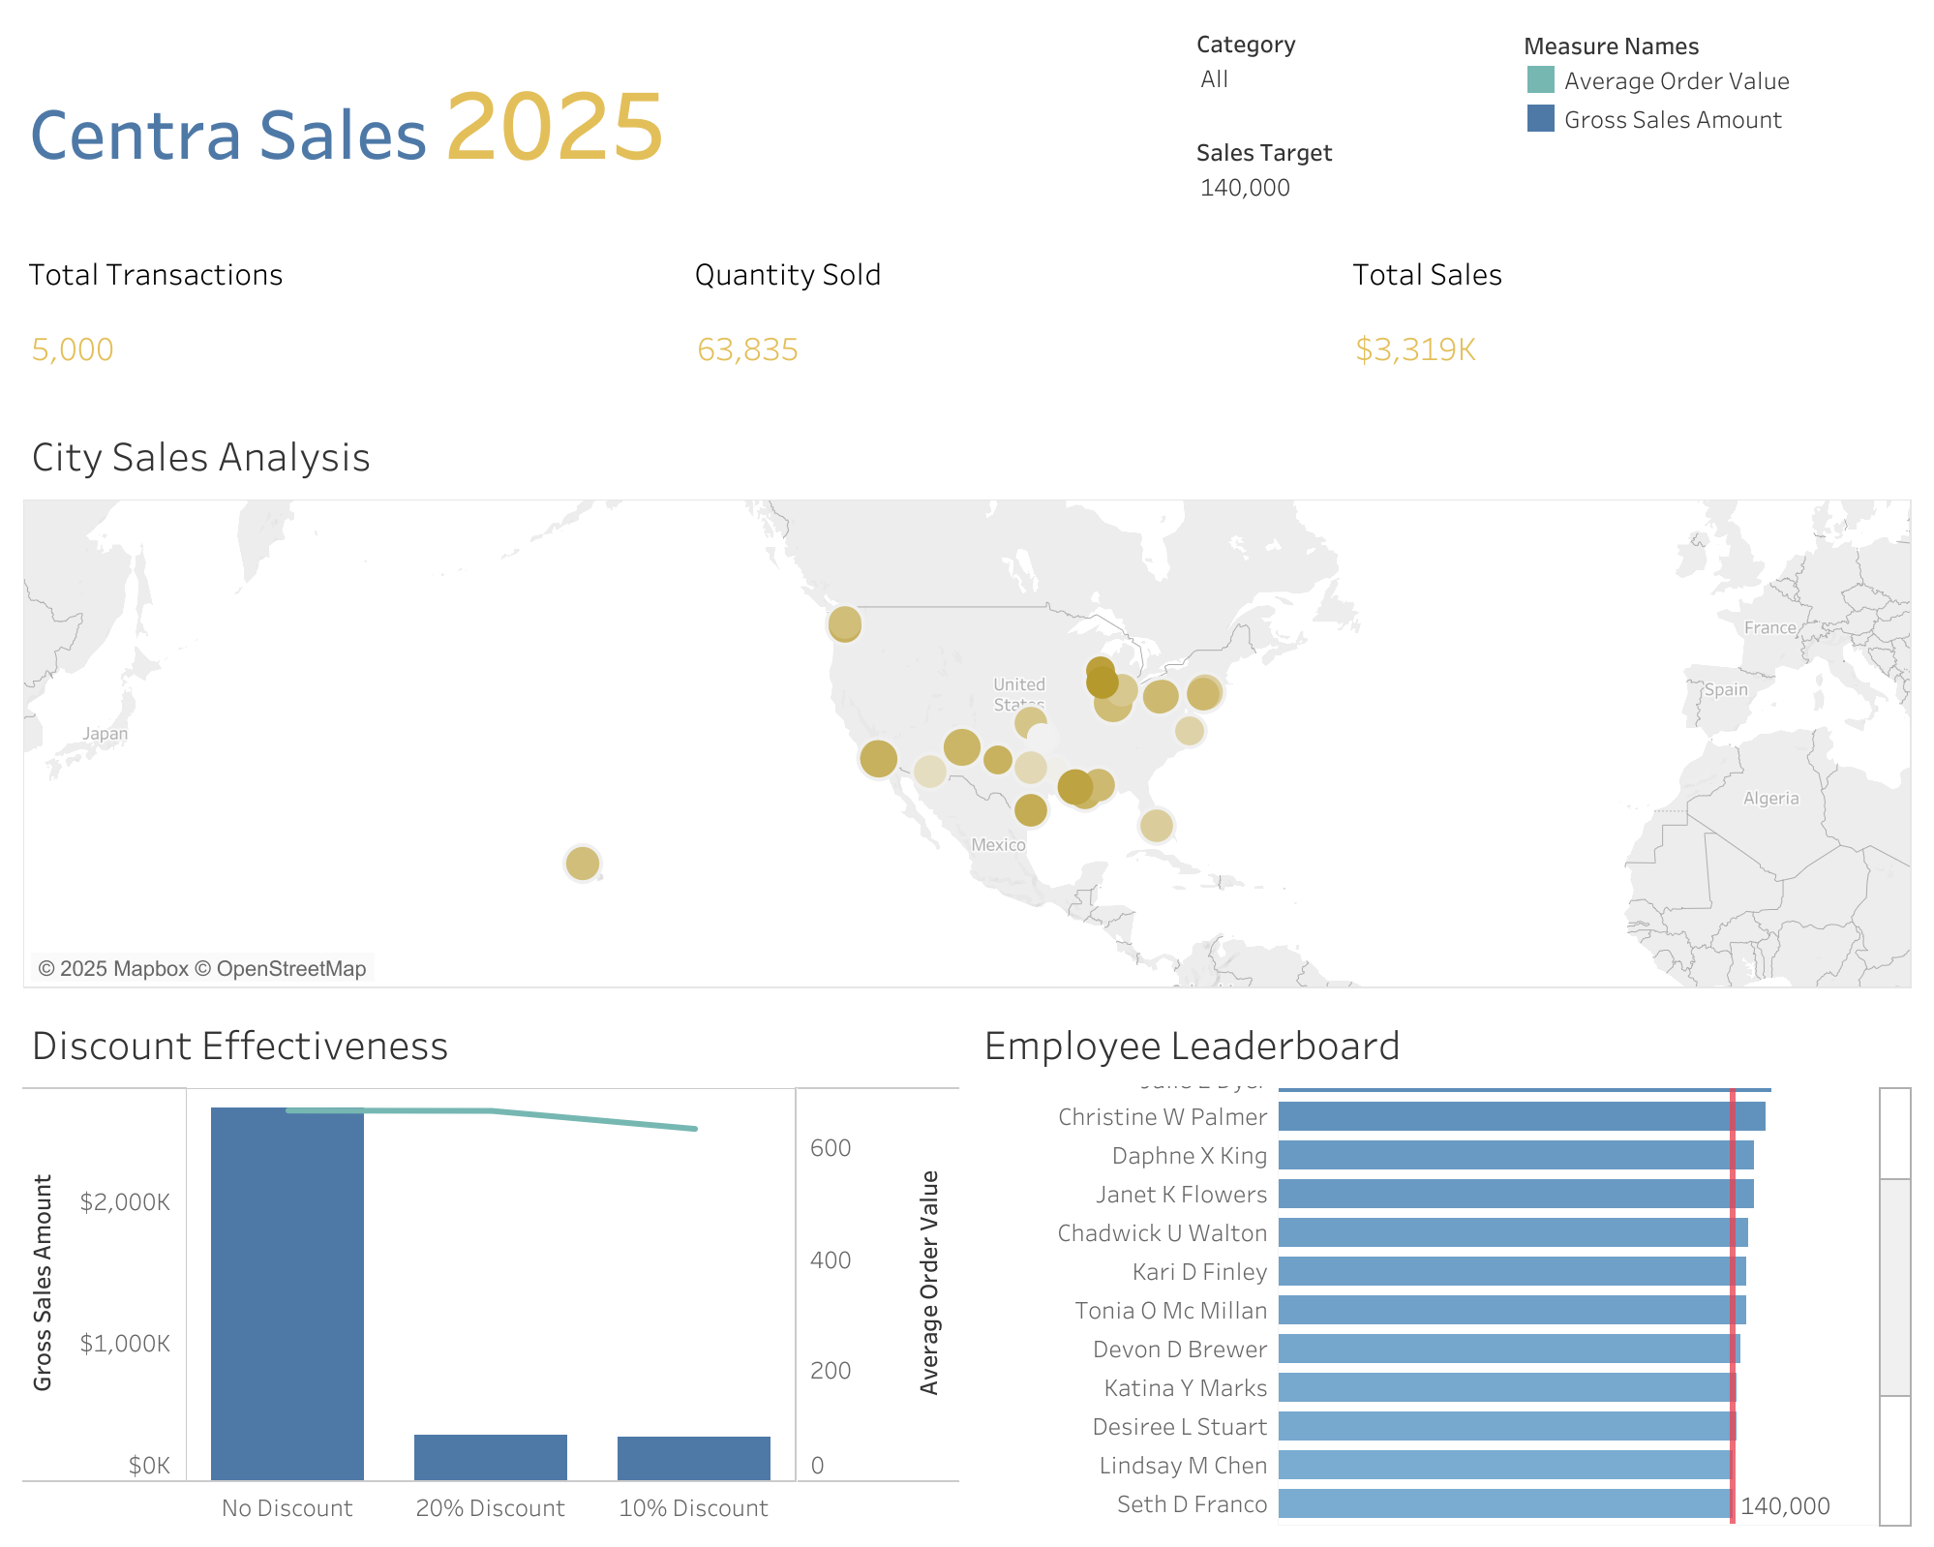
Tableau Dashboard

Slide 12
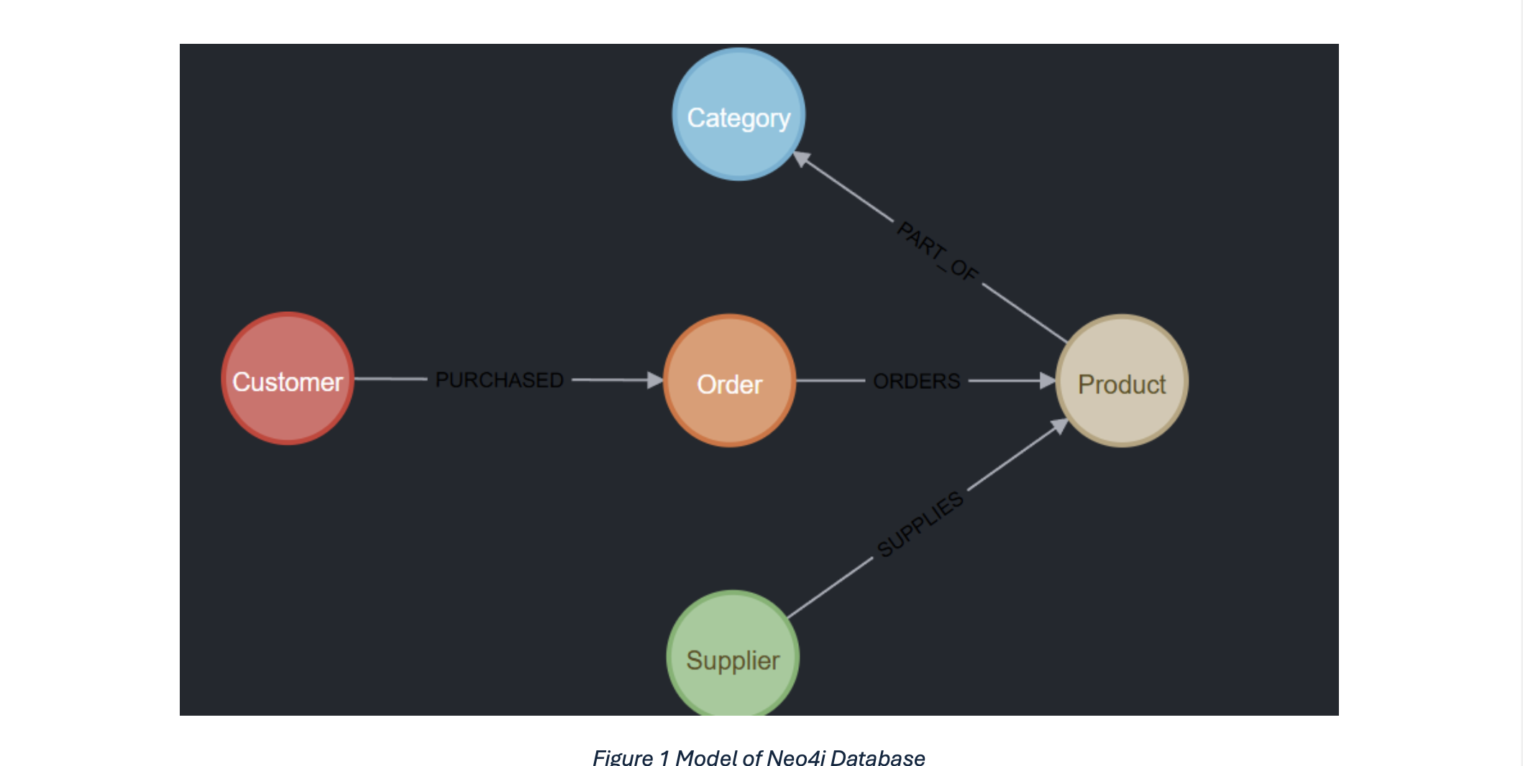
Neo4J Database

Slide 13
SQL vs. CQL: Performance Comparison
SQL (Relational Database)
Model: Structured tables joined by keys.
Core Strength: Highly optimized for aggregations (SUM, COUNT) and straightforward data lookups.
Key Challenge: Performance slows down significantly with complex queries that require multiple JOINs.
CQL (Graph Database)
Model: A network of connected nodes and relationships.
Core Strength: Extremely fast for "multi-hop" queries that analyze deep, complex relationships and patterns.
Key Challenge: Can be less performant for certain full-database aggregations compared to mature SQL systems.
Verdict : Use SQL for structured data and aggregations; use CQL for highly connected data where the relationships are key.

Slide 14
Q / A - Session

